Slide 1
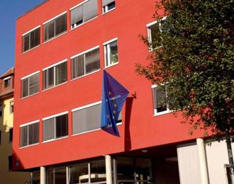
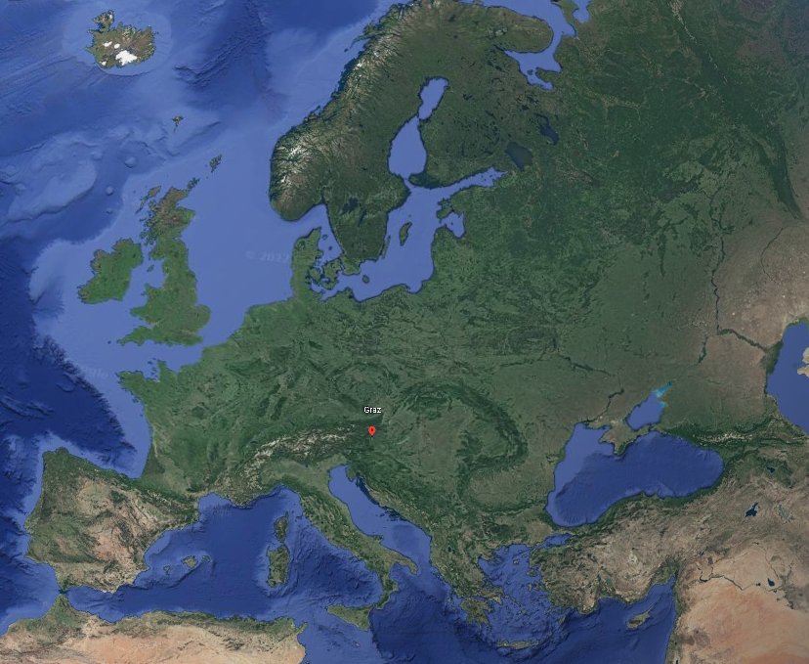

Welcome to the ECML!
The European Centre for Modern Languages of the Council of Europe
Bienvenue au CELV !
Le Centre européen
pour les langues vivantes
du Conseil de l’Europe

Slide 2
Welcome to the ECML
The European Centre for Modern Languages of the Council of Europe
Overview
Council of Europe
Council of Europe – language policy
The role of the ECML
ECML programme 2020-2023
ECML projects – resources – training and consultancy
Examples of resources
Policy for inspiring practice
Stay connected

Slide 3


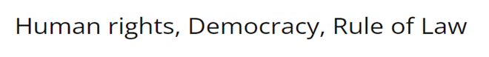
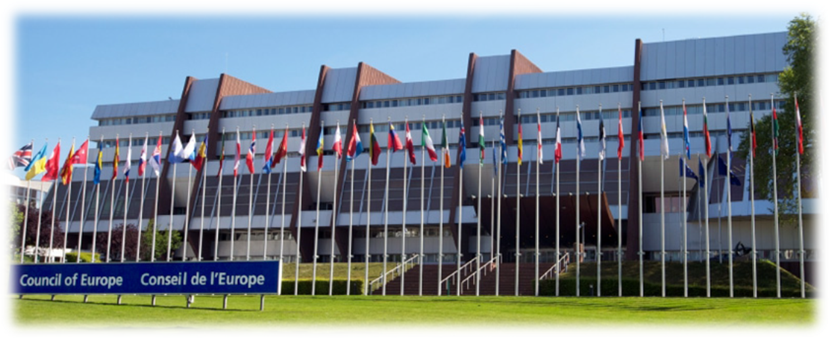

Council of Europe
“What kind of society
will our children
live in tomorrow?”¹
46 member states
¹ Council of Europe (2018): Reference Framework of Competences for Democratic Culture. Volume 1, p.7

Slide 4
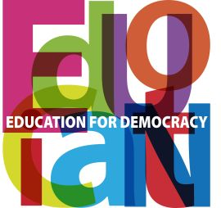
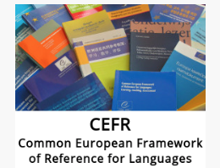
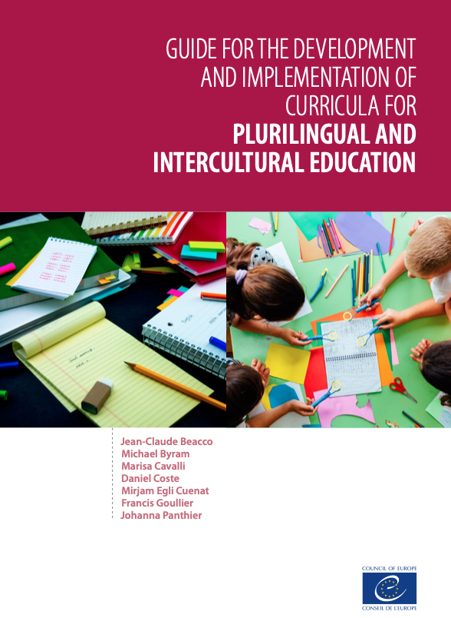
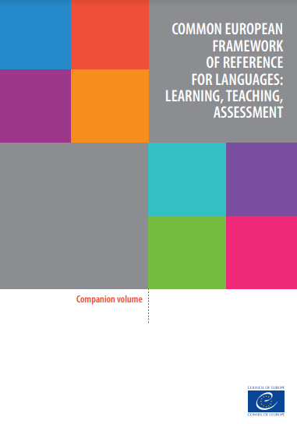
Council of Europe – language policy
The learner and the languages present in school
LANGUAGE(S)
OF SCHOOLING
Regional, minority and migration languages
Foreign languages – modern and classical
Language as a subject
Language(s) in other subjects
Platform of resources and references for plurilingual and intercultural education
www.coe.int/lang

Slide 5
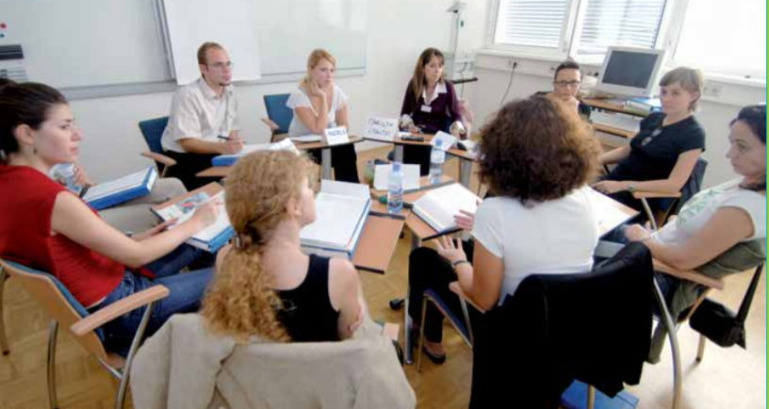

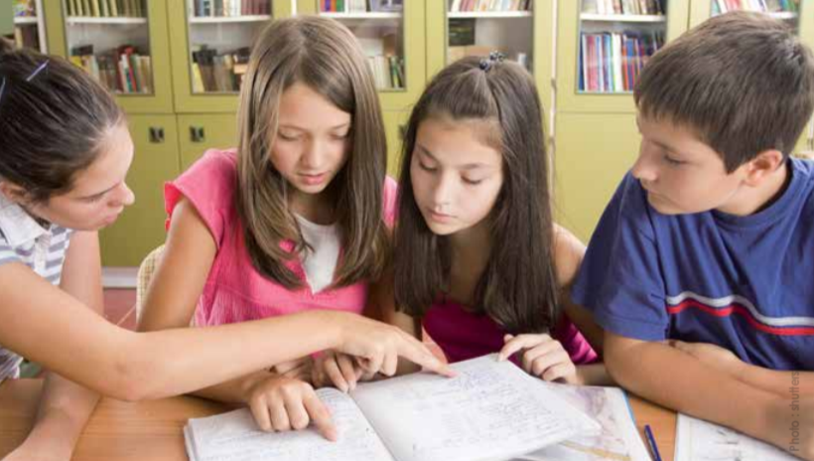
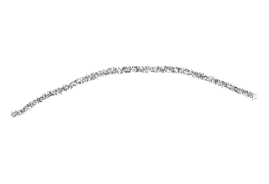
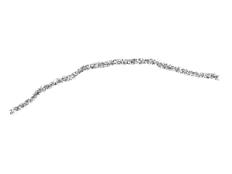
What is the role of the ECML?
Curricula
Teacher education
Classroom practice
Research
European policy
National policy
Bridging policy and classrom practice

Slide 6
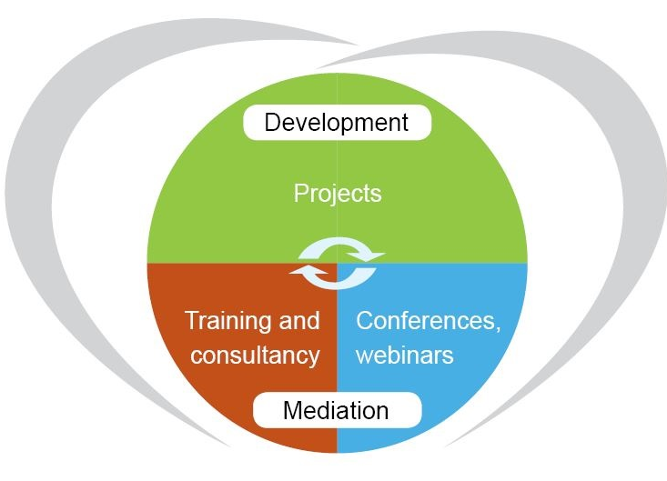
ECML programme 2020-2023
ECML programme 2020-2023
Language-sensitive teacher education
Transversal competences
Pluralistic teacher competences
CLIL in languages other than English
Home languages of migrant children
Cross-border vocational learning
CEFR companion volume
Early language learning
Linguistic mediation
Digital citizenship
www.ecml.at/inspiringinnovation

Slide 7
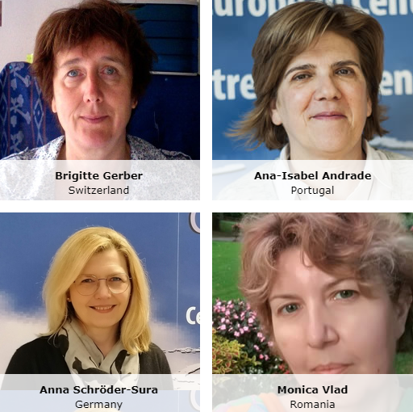
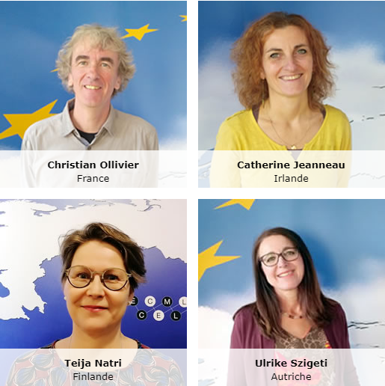
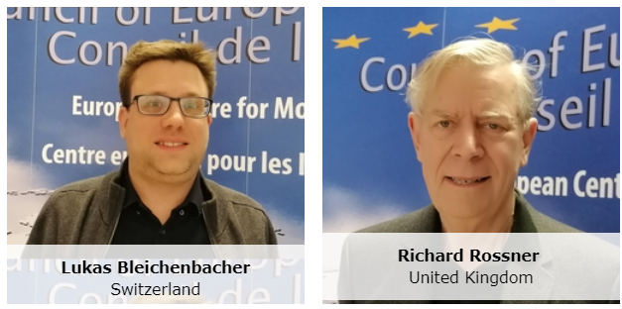
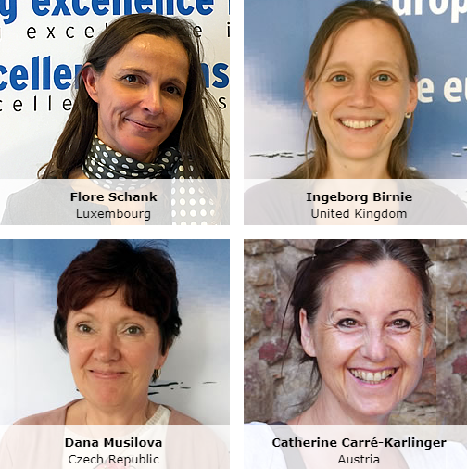
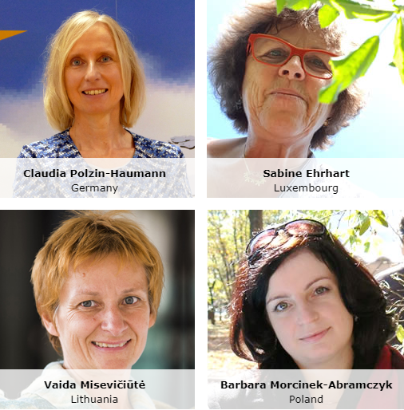
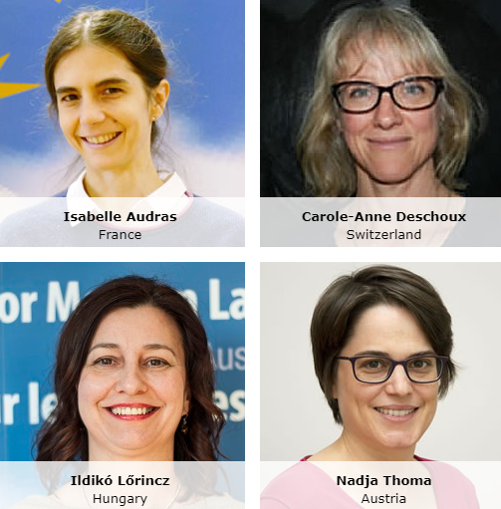
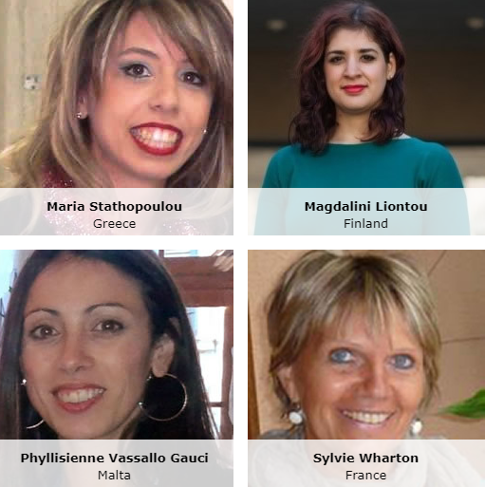
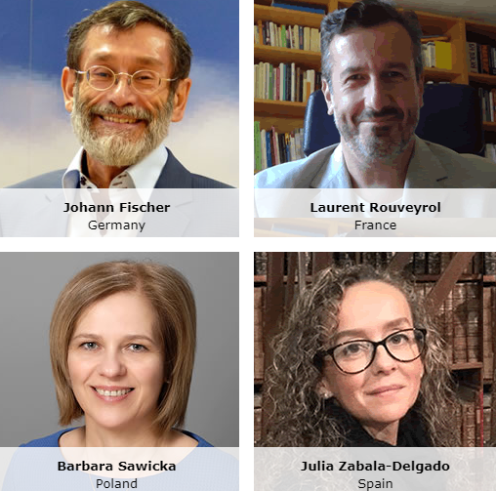
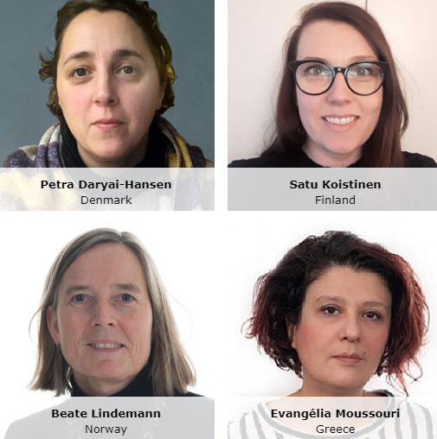
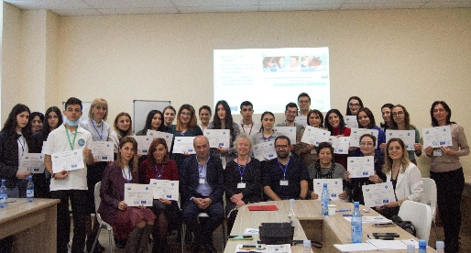
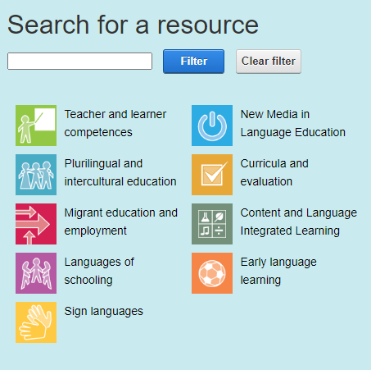
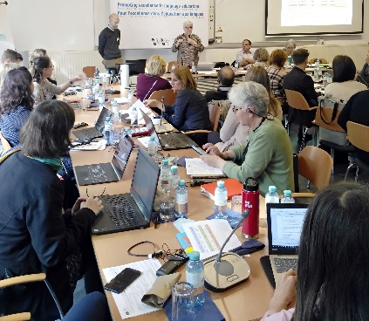
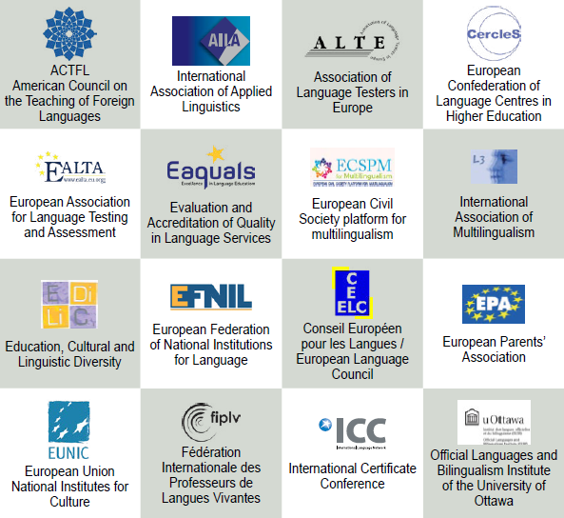
ECML projects – resources – training and consultancy
ECML projects – resources – training and consultancy
European expert collaboration
Piloting and review of resources
Publication, dissemination
Training and consultancy

Slide 8
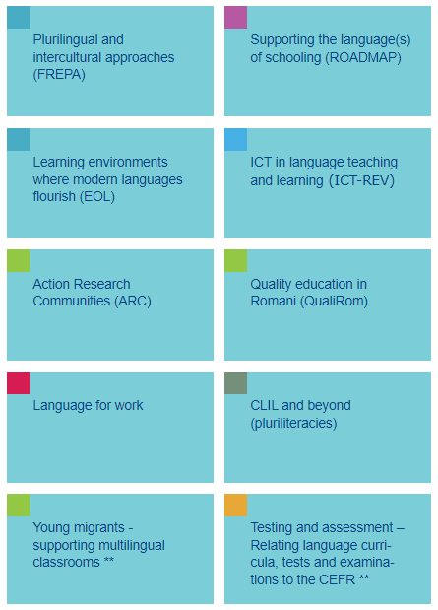
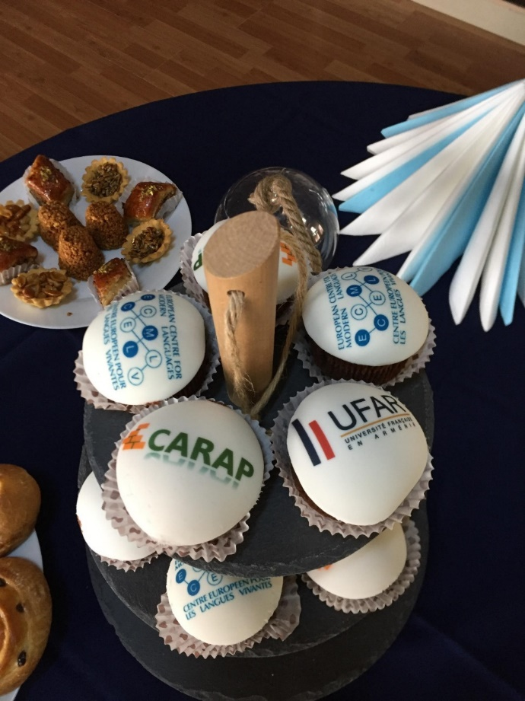
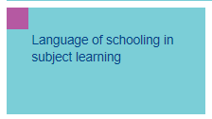
ECML training and consultancy
ECML training and consultancy
“The event provided tangible examples from other countries which can be implemented in our country.”
“The combination of solid academic evidence, along with practical tools was particularly useful.”

Slide 9
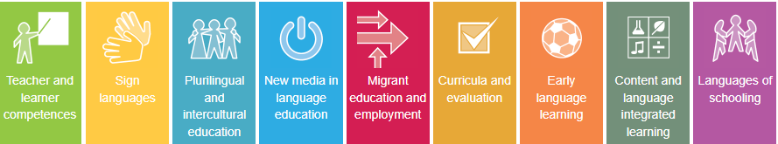
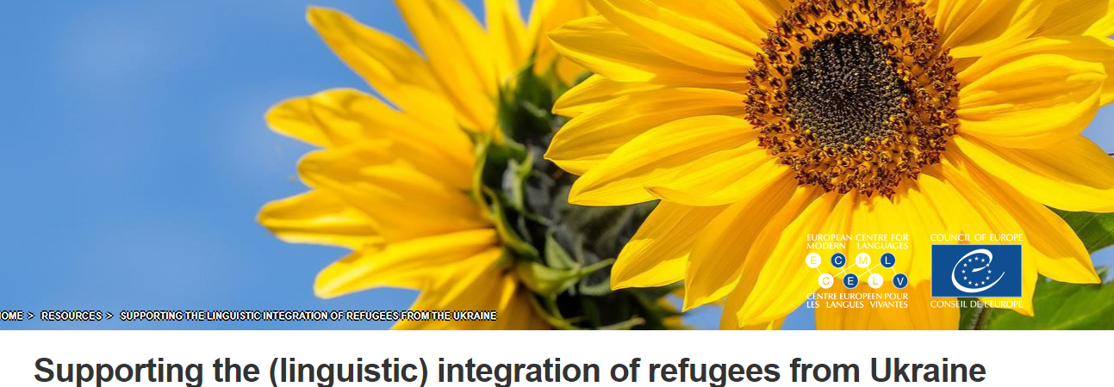
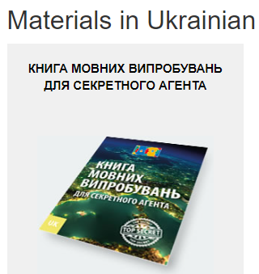
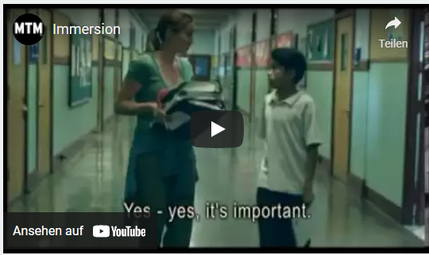
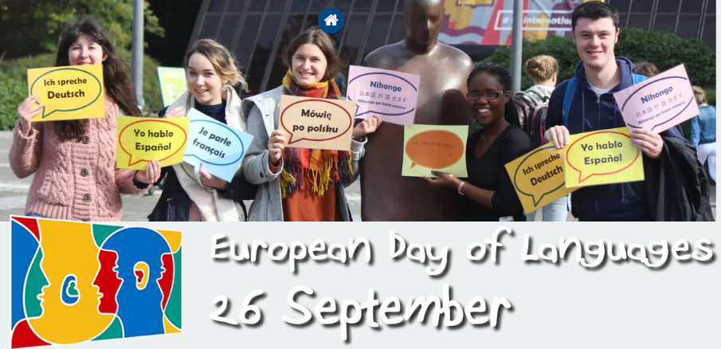
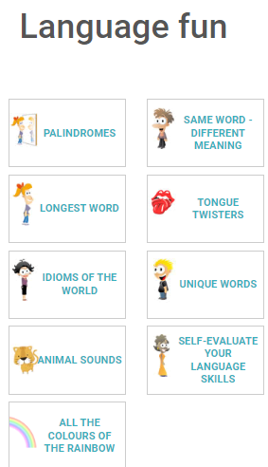
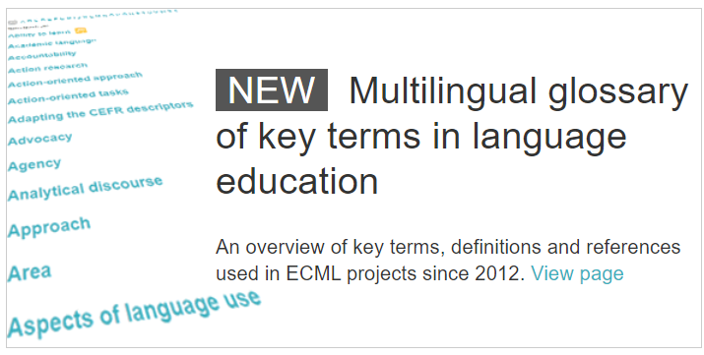
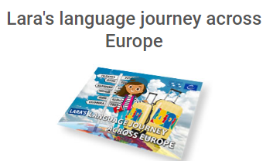
www.ecml.at/ukraine
www.ecml.at/glossary
edl.ecml.at

Slide 10
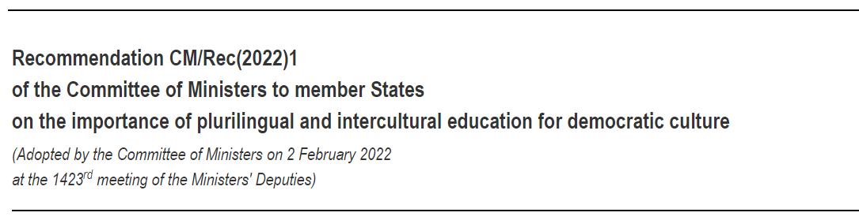
Policy for inspiring practice
“... support collaboration between educational and cultural institutions, civil society and businesses to promote plurilingual and intercultural learning for democratic culture”

Slide 11



www.ecml.at
“What kind of society
will our children
live in tomorrow?”

